Slide 1
CZM
Zeng jianming

Slide 2
Recap
Scope / data structure
Future study

Slide 3
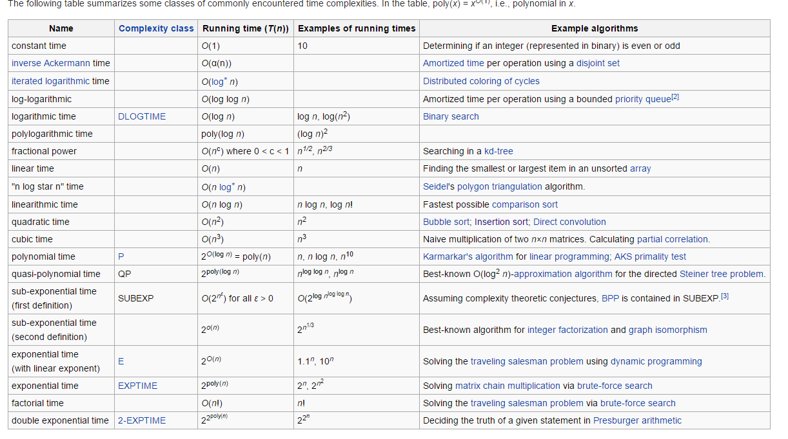
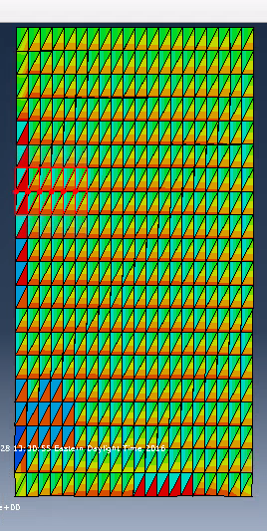
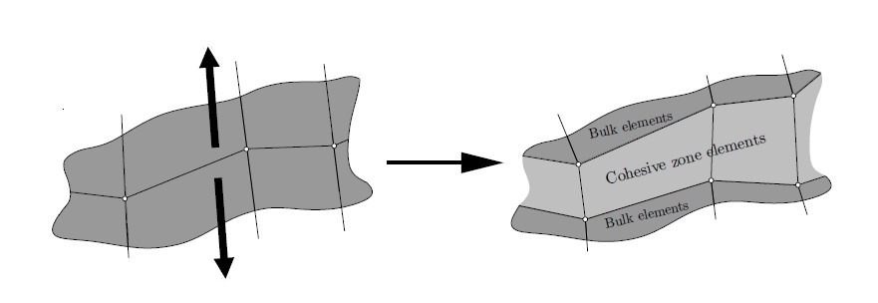
Recap

Slide 4
New mission → CPE4
Inclusion (in progress)
Crack (finish)

Slide 5
Scope / data structure
"All that is complex is not useful. All that is useful is simple." – Mikhail Kalashnikov
Read_from_abaqus.py
Coh.py
CZM.py
Mesh.py
Mesh.py
node
element
Mesh.py
Node set
Element(CPE3)
Element(CPE4)
Node(2D)
Element set
Surface
Element side set

Slide 6
Debug
Generic
*Node
1, -15., -20.
2, 0., 0.
3, -30., 0.

Slide 7
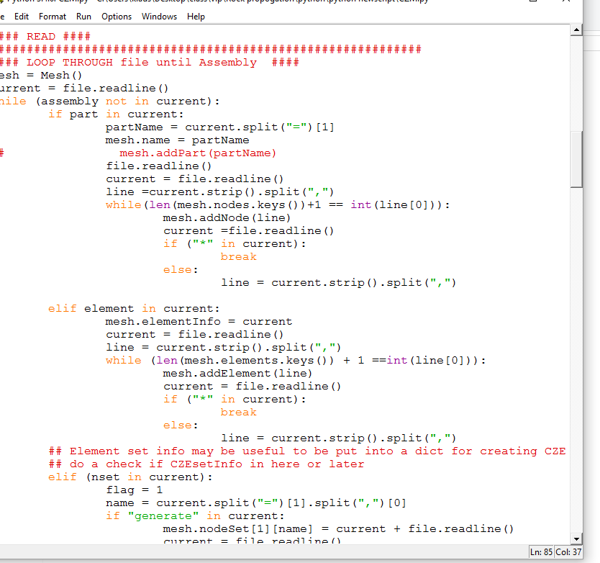
class Node2D:
## Local param
ID = None
x = None
y = None
def __init__(self, ID, x, y):
if ((not isinstance(ID, int))
or ((not isinstance(x, int))and (not isinstance(x, float)))
or ((not isinstance(y, int))and (not isinstance(y, float)))):
raise TypeError("Node class: one or more Node object arguments are invalid")
self.ID = ID
self.x = x
self.y = y

Slide 8
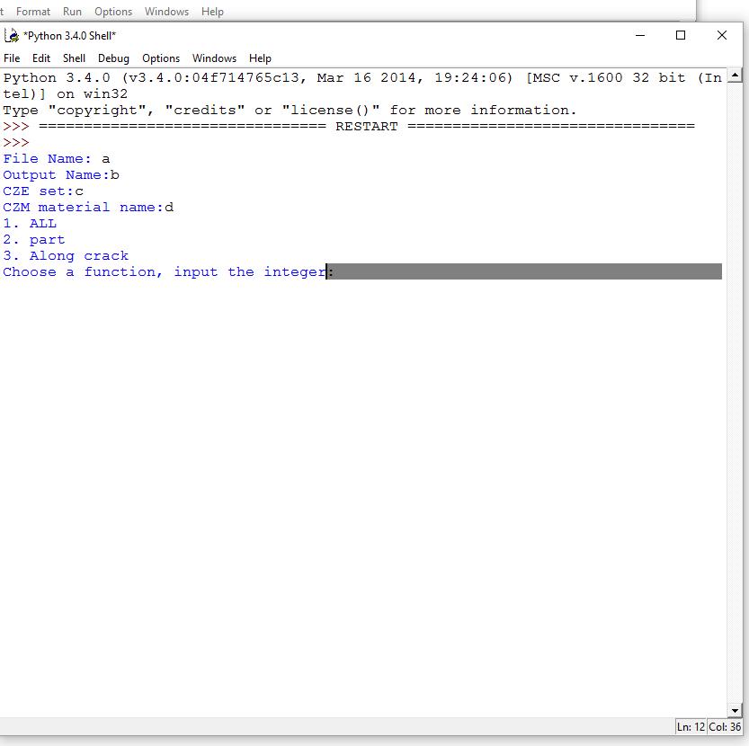
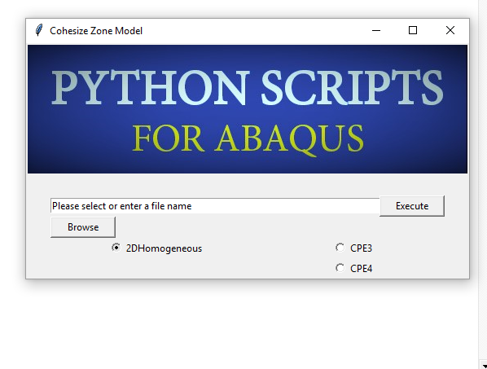
Future Study

